Slide 1
Microbial Genome and Microbiome Analysis
Course overview
Phuc Loi Luu, PhD
Luu.p.loi@googlemail.com

Slide 2
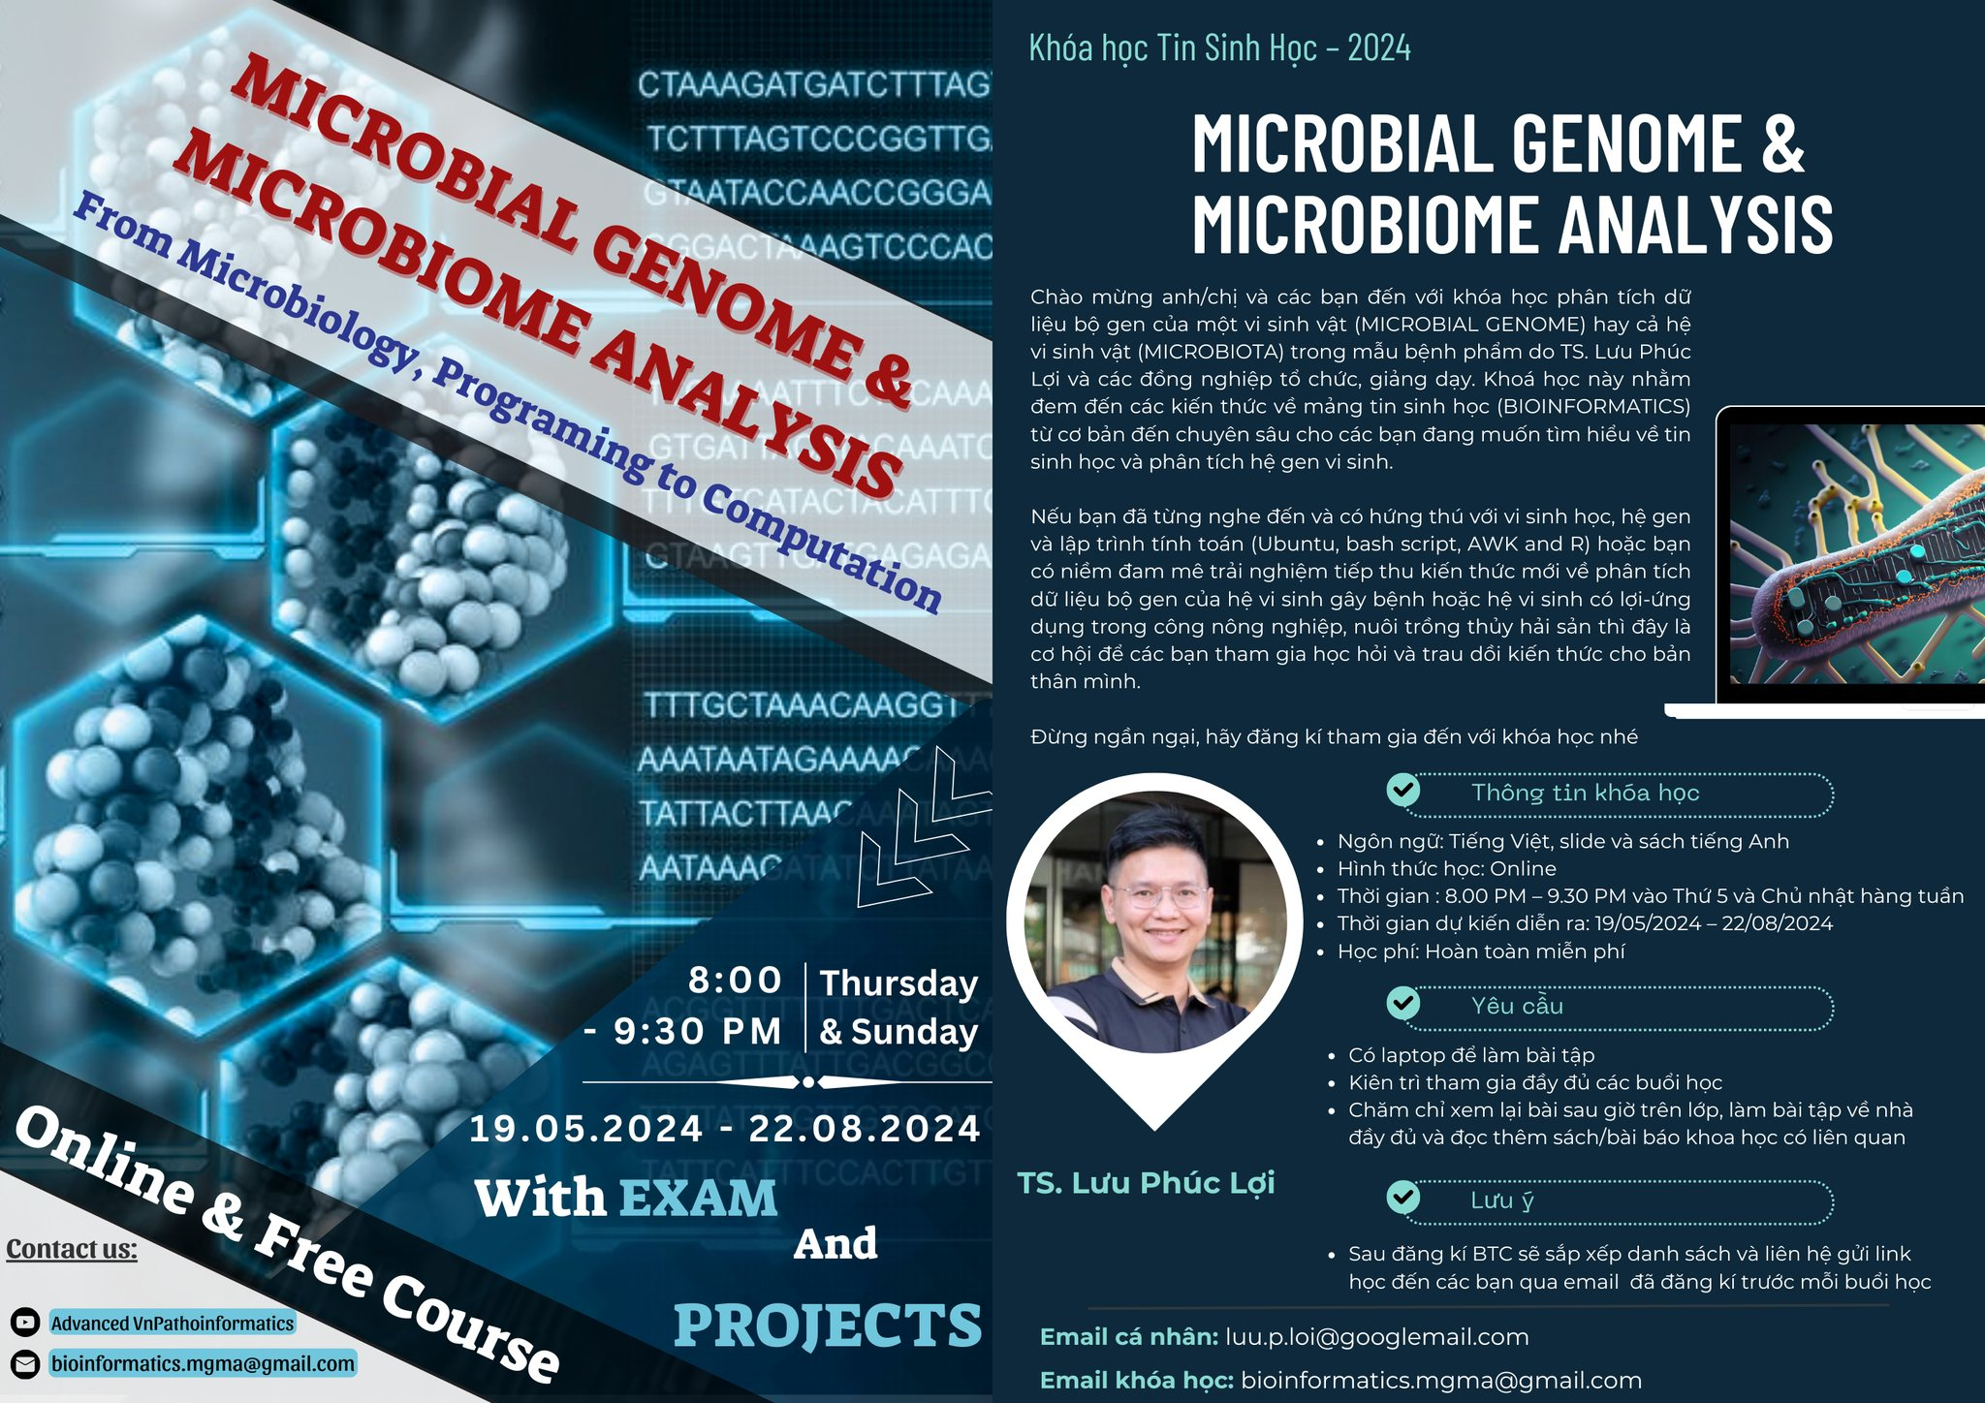

Slide 3
Content
The Teams help US!
Some terms and concepts of Microbial Genome and Microbiome
What we will learn from the course?

Slide 4















TEAM TRỢ GIẢNG
Nguyễn Quang Khải
nguyenkhai12330@gmail.com
Hà Gia Huy
hagiahuy311@gmail.com
Hồ Phú Quý
hophuquy0944@gmail.com
Hoàng Sơn
hoangsonltt710@gmail.com
Minh Nguyễn
ducminhnguyenle30091996@gmail.com
Nguyễn Quỳnh Như
Lucianhu@gmail.com
Mỹ Quí
ttmqui1912@gmail.com
Duy Đào
khuongduying@gmail.com
Ngô Đại Phú
phudaingobio@gmail.com
Duy Thanh Nguyễn
duythanh200620@gmail.com
Lan Nguyễn
nguyenlethuylan02@gmail.com
Phạm Văn Quan
quanpham0512@gmail.com
Trịnh Duy Khang
duykhang.trinh1308@gmail.com
Trần Bùi Minh Trí
minhtritran21062001@gmail.com
Nguyễn Thị Mỹ Ái
nguyenthimyai04122016@gmail.com

Slide 5



TEAM HẬU CẦN
Hoàng Kim
vanhohoangkim@gmail.com
Nguyễn Lê Quang
quanglequang2003@gmail.com
Huỳnh Khôi Minh Uyên
uyenhuynhkhoiminh.1.1@gmail.com

Slide 6
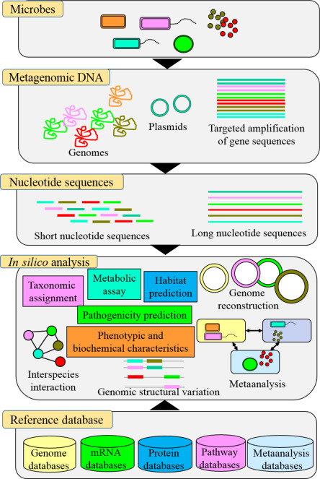
Some terms and concepts of Microbial Genome and Microbiome
https://www.sciencedirect.com/topics/medicine-and-dentistry/microbial-genome

Slide 7
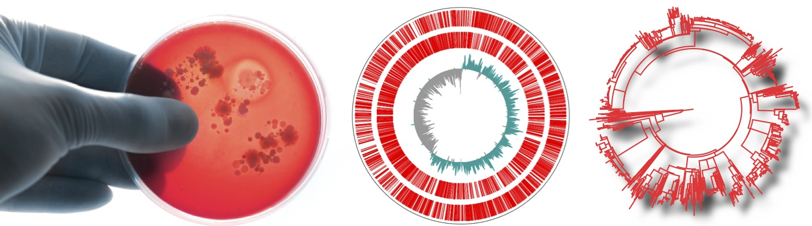
Microbial Genome Analysis: study one isolate at once
Culture microbe
Genome Sequencing
Serotyping/genotyping
Microbe = Microorganism; Prokaryotes = Bacteria & Archaea

Slide 8
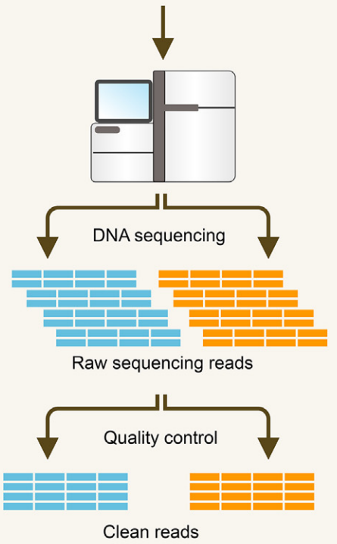
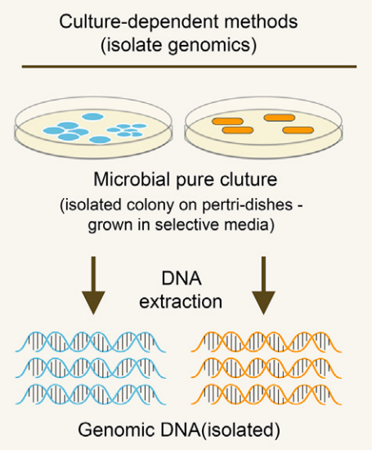
Microbial Genome Analysis: study one isolate at once
Biological sample collection
10.1016/j.csbj.2021.11.028

Slide 9
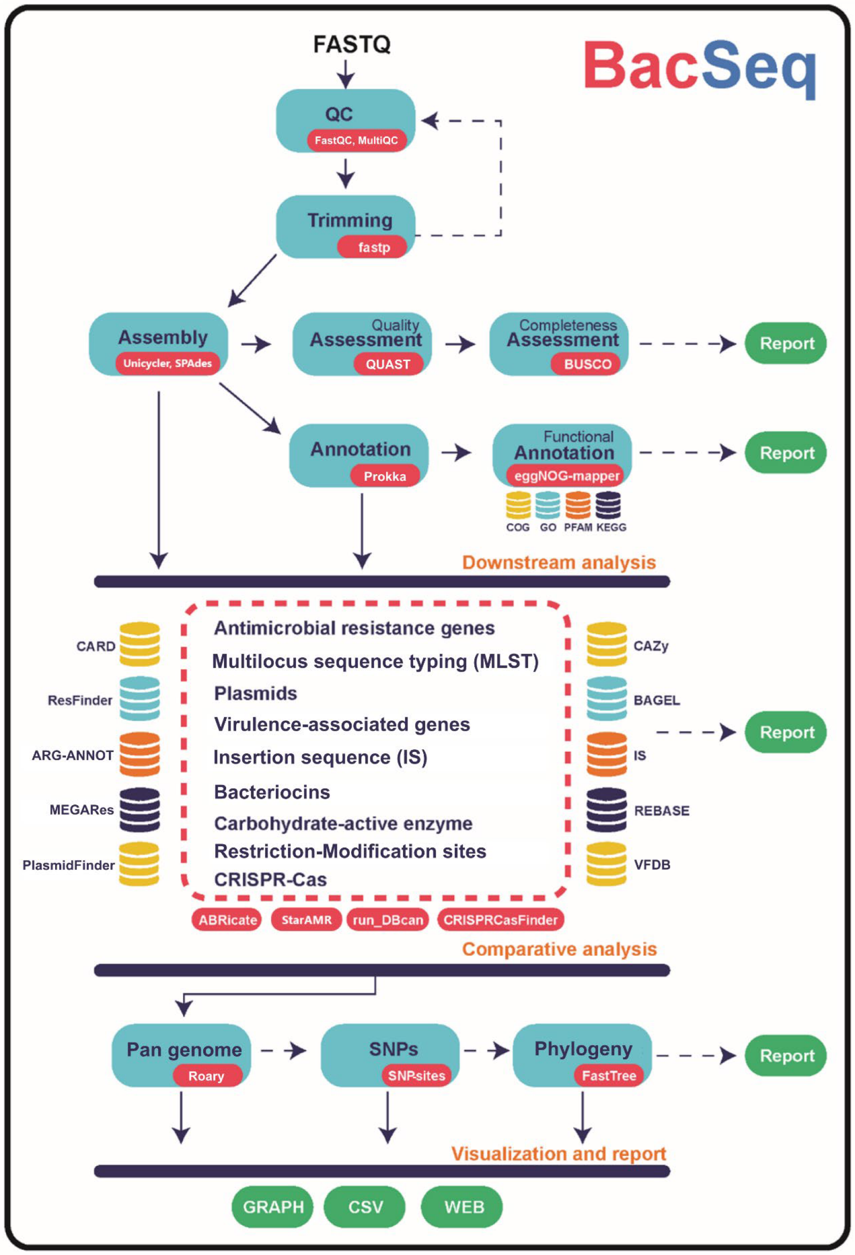
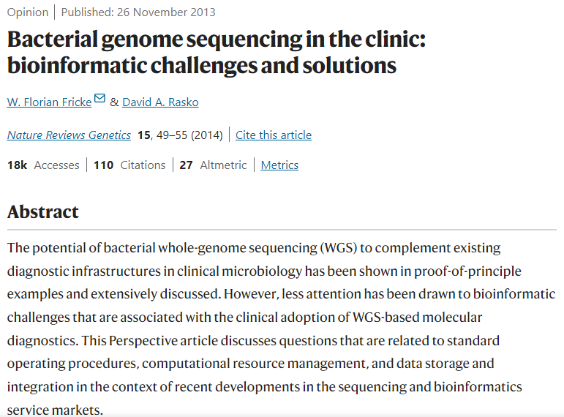

Slide 10
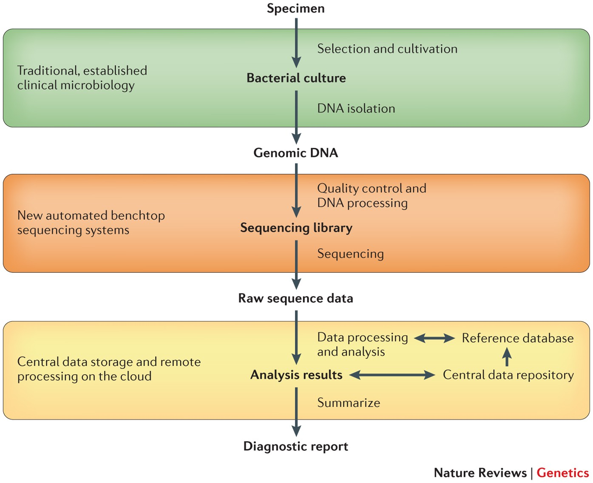
A summary of the proposed workflow is shown for bacterial whole-genome sequencing (WGS)-based molecular diagnostics (MDx), which uses benchtop sequencing for decentralized sequence generation, as well as the cloud for both central data storage and remote data processing. Double-headed arrows indicate that the central data repository and reference database are constantly updated on the basis of new analysis results.

Slide 11
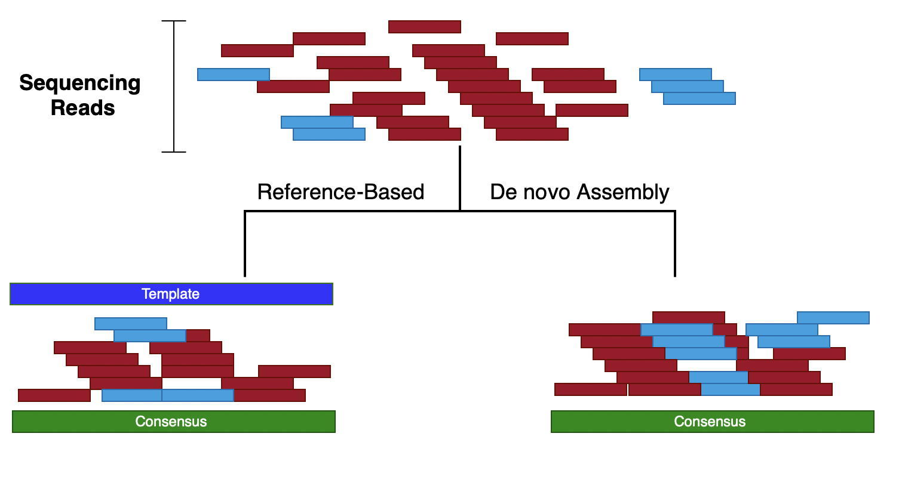

Bioinformatic Upstream analysis
10.3390/microorganisms11071769

Slide 12
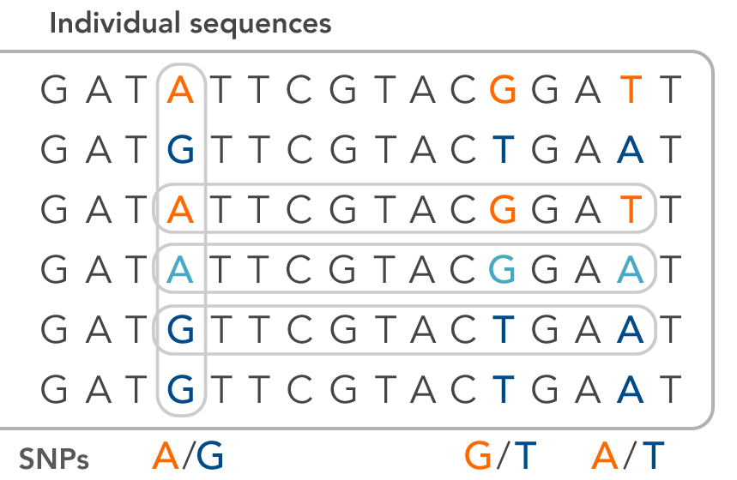

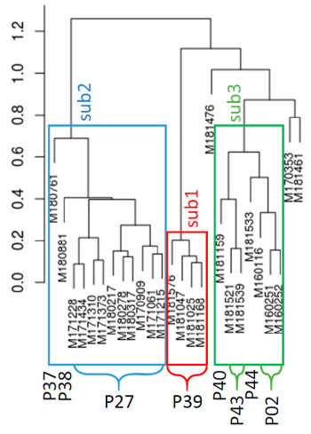
Bioinformatic Downstream analysis
SNP calling
Phylogeny tree predicting
10.3390/microorganisms11071769

Slide 13
Methods
No | Sequencing Platforms | Read mapping | Variant calling | De novo assembly | Annotation | phylogenetic tree
1 | Illumina GAIIx and HiSeq | BWA | SAMtools |  |  | SplitsTree4, PhyML and BEAST
2 | 454 GS FLX, Illumina HiSeq, Ion Torrent PGM and Pacific Biosciences RS II |  | Mummer | AMOS assembly, assembler ALLORA, minimus2 and BLASTR | Glimmer, GeneMarkS, BLASTp, InterProScan, SignalP and VFDB virulence factor database | Mugsy, MUMmer, SeqAn, Gblocks and RAxML
3 | 454 GS FLX and Illumina GAIIx | Bowtie | SAMtools | Velvet and Newbler
4 | 454 GS FLX |  | Mauve | Newbler | NCBI PGAAP
5 | Illumina MiSeq | SMALT | SSAHA |  |  | RAxML
6 | Illumina MiSeq and HiSeq | BWA |  | Ray Meta |  | Bowtie and Metaphlan
Notes:
BCF, binary call format; BEAST, Bayesian evolutionary analysis by sampling trees; BWA, Burrows–Wheeler aligner; GAIIx, Genome Analyzer IIx; GARLI, genetic algorithm for rapid likelihood inference; GS FLX, genome sequencer FLX; NCBI, National Center for Biotechnology Information; PGAAP, prokaryotic genomes automatic annotation pipeline; PGM, personal genome machine; PhyML, phylogenetic estimation using maximum likelihood; RAxML, randomized axelerated maximum likelihood; SAM, sequence alignment/map; SNP, single-nucleotide polymorphism; SSAHA, sequence search and alignment by hashing algorithm; WGS, whole-genome sequencing.

Slide 14
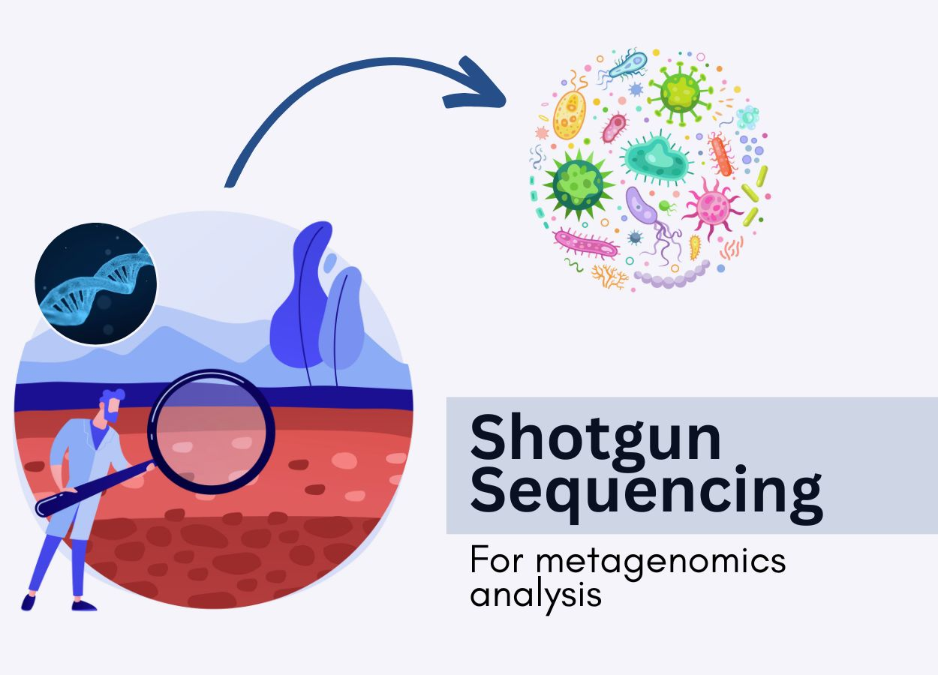
Metagenomics/ Microbiome
Notes:
BCF, binary call format; BEAST, Bayesian evolutionary analysis by sampling trees; BWA, Burrows–Wheeler aligner; GAIIx, Genome Analyzer IIx; GARLI, genetic algorithm for rapid likelihood inference; GS FLX, genome sequencer FLX; NCBI, National Center for Biotechnology Information; PGAAP, prokaryotic genomes automatic annotation pipeline; PGM, personal genome machine; PhyML, phylogenetic estimation using maximum likelihood; RAxML, randomized axelerated maximum likelihood; SAM, sequence alignment/map; SNP, single-nucleotide polymorphism; SSAHA, sequence search and alignment by hashing algorithm; WGS, whole-genome sequencing.

Slide 15
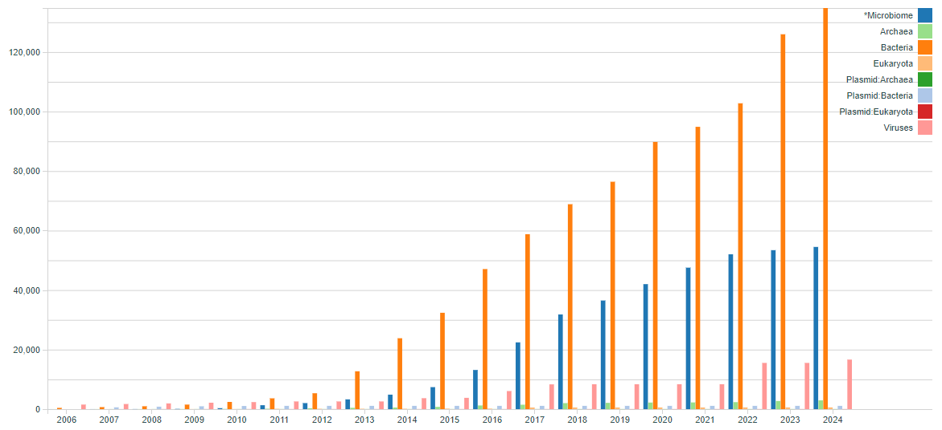
From Microbial Genome to Microbiome
The number
of genomes
in IMG
https://img.jgi.doe.gov/cgi-bin/m/main.cgi?section=IMGContent&page=contentHistory

Slide 16
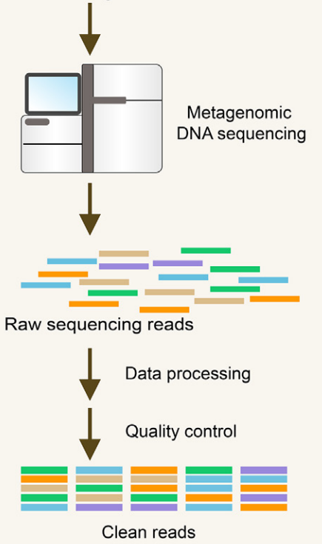
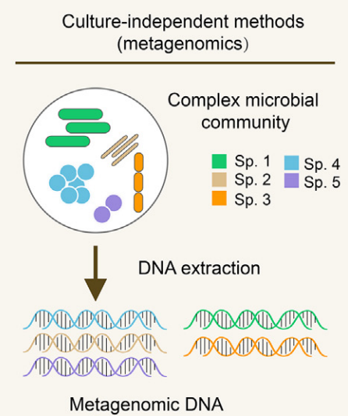
Microbiome Analysis: study of microbiota
Biological sample collection
10.1016/j.csbj.2021.11.028

Slide 17
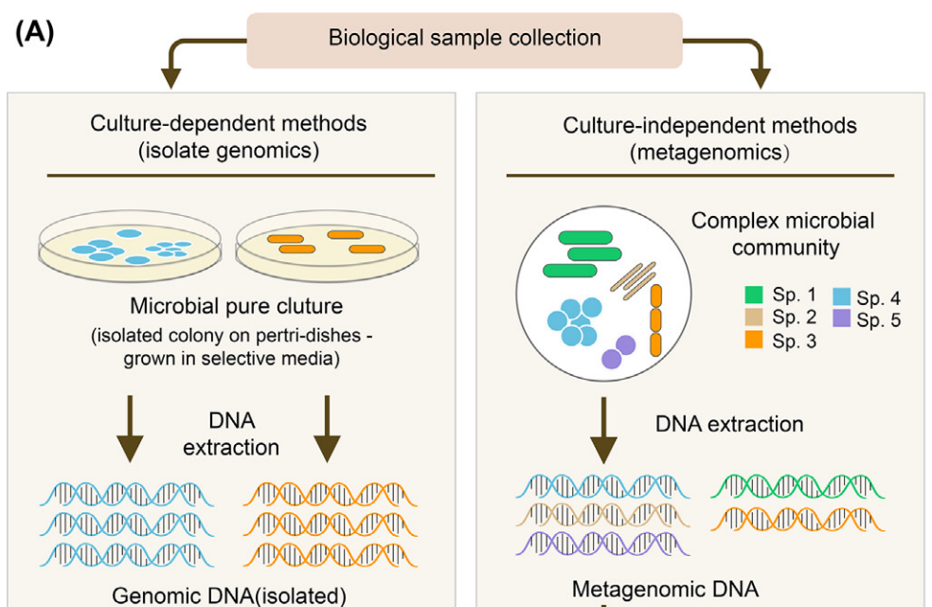
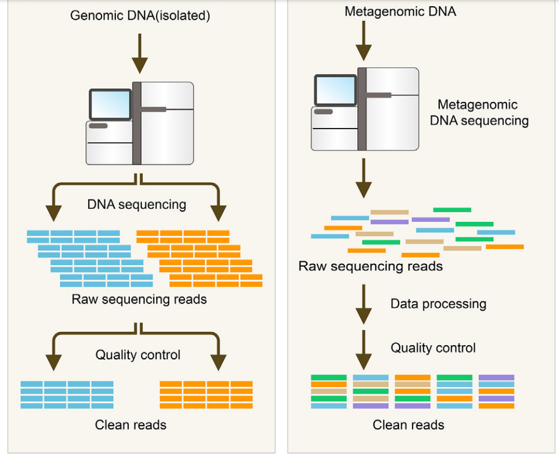
Microbial Genome vs Microbiome Analysis
10.1016/j.csbj.2021.11.028

Slide 18
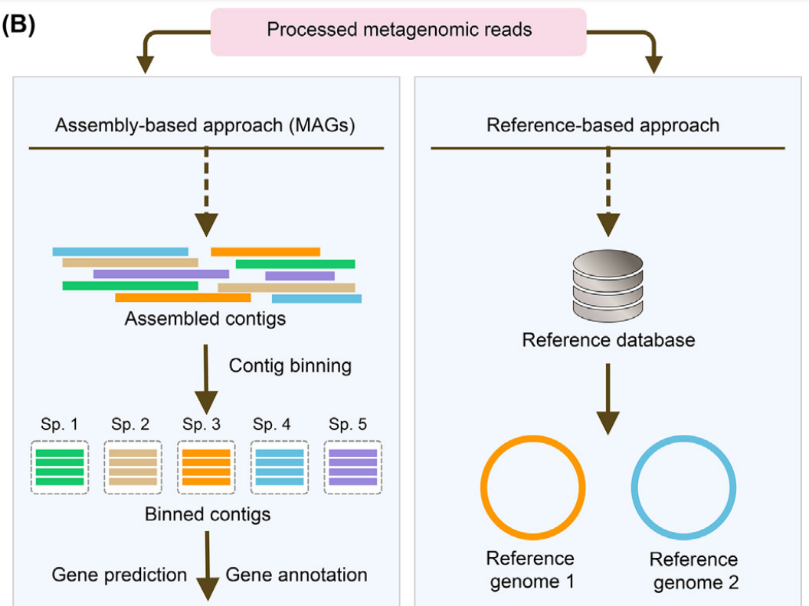
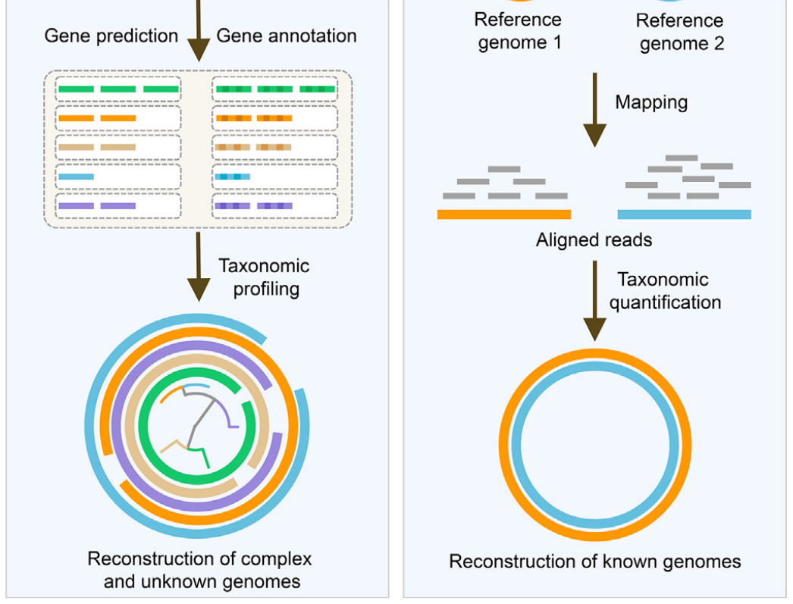
Shotgun Microbiome Analysis
10.1016/j.csbj.2021.11.028

Slide 19
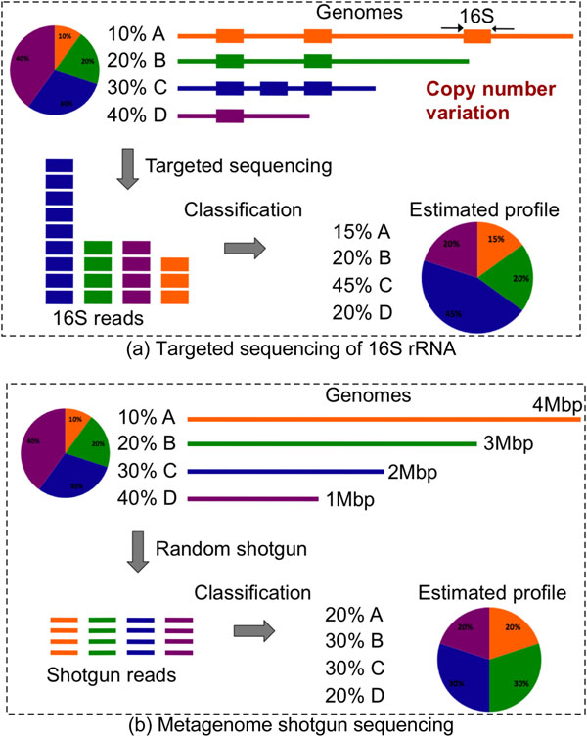
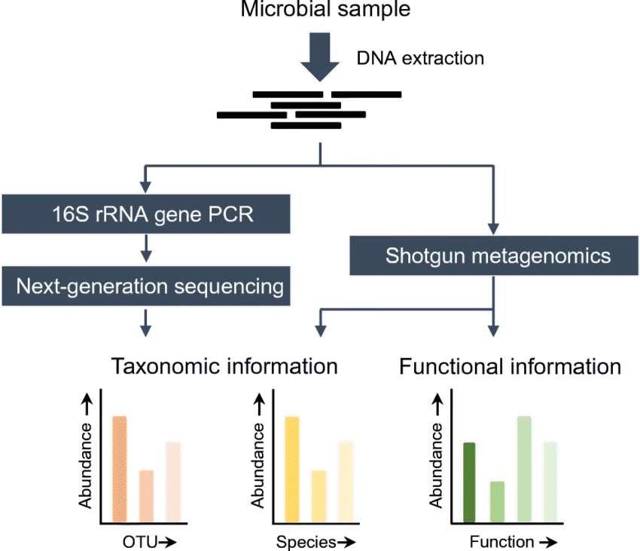
Target vs Shotgun Microbiome Analysis
10.1186/1471-2164-12-S2-S4
10.1007/s10096-019-03520-3

Slide 20
What we will learn from the course?
Install and use Ubuntu OS
Master programming language (Bash and R), Linux command line, and some bioinformatic tools
Manipulate Next Generation Sequencing data of WGS and Metagenomics
Plot a read-for-publication figures and statistical analysis for a manuscript
Downstream analysis of WGS and Metagenomic data
Read a publication of WGS and Metagenomics

Slide 21
Thank you for your listening!

